Slide 1

Symptom Checker
Identify possible conditions related to your symptoms. And list you top related disease for your symptoms.

Slide 2

Introduction:-
A symptom is a physical or mental feature which is regarded as indicating a condition of disease, particularly such a feature that is apparent to the patient.
We will try to identify you most probable disease, through our symptoms.
We commonly gets confuse between sign and symptom, A symptom is a manifestation of disease apparent to the patient himself, while a sign is a manifestation of disease that the physician perceives. The sign is objective evidence of disease; a symptom, subjective.

Slide 3

Individuals can’t visit to doctor for every since cause, sometimes they take their own personal home remedies, but in some cases those symptoms are not curable by home treatments. So this a model in which on selecting symptoms it will show disease related to those symptoms. Which will further guide a person to take a medical treatment under which domain.

Slide 4


Steps I follwed to create this with machine learning model:-
Collected dataset and read those csv files by importing pandas library.
Read files and removed al null values and all csv’s
Merge dataset according to requirements.
Used label Encoder to simply convert each value in a column to a number.
used coo_matrix to convert spare matrix into COOrdinate format.
used csr_matrix to Compressed Sparse Column matrix

Slide 5

Normalized model:-Normalization is a technique often applied as part of data preparation for machine learning. The goal of normalization is to change the values of numeric columns in the dataset to use a common scale, without distorting differences in the ranges of values or losing information.

Slide 6

Imported svd from scipy.Sparse linalg
Sparse:-A sparse feature is a feature that that has mostly zero values. For example, a word count.
SVD(Singular value decomposition):-In linear algebra, the singular value decomposition (SVD) is a factorization of a real or complex matrix that generalizes the eigen decomposition of a square normal matrix to any. matrix via an extension of the polar decomposition.

Slide 7
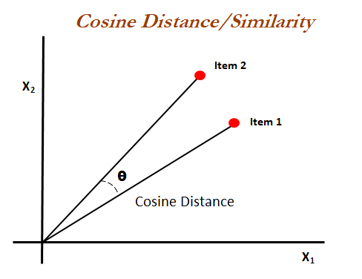
Cosine Similarity:-
Cosine similarity is a metric used to measure how similar the documents are irrespective of their size. Mathematically, it measures the cosine of the angle between two vectors projected in a multi-dimensional space
Used cosine similarity which will distinguish overlapping

Slide 8


Conclusion:- Show most probably disease an individual may have , So he/she can cure before its to late
YOU HAVE TO FIGHT FOR YOUR HEALTH AND STAY ON TOP OF IT. OUR BODIES ARE MENT TO BE HEALTHY.

